Slide 1
BITS PILANI (WORK INTEGRATED LEARNING PROGRAMMES)
Deep Reinforcement Learning — Assignment Problem 1
A Framework for Fair Evaluation of
Variance-Aware Bandit Algorithms
Elise Wolf, University of Mannheim — arXiv:2510.27001 (2025)
Group 8 — Contributors
1. CHANDAN SINGH BAGHEL — BITS ID: 2025AG05120
2. DIVAKARAN RAMU — BITS ID: 2025AG05828
3. KURELLA MADHULATHA — BITS ID: 2025AG05826
4. AKASH CHOUDHURY — BITS ID: 2025AG05368
Group 8 | DRL Assignment Problem 1 | Variance-Aware Bandits | Slide 1 of 23

Slide 2
Motivation & Research Objective
Why fair comparison of bandit algorithms is an open problem
Multi-armed bandits are the simplest building block of reinforcement learning. Variance-aware extensions of UCB are theoretically promising, yet the field lacks a reproducible, standardized way to compare them against classical methods — existing studies vary in setup, use narrow metrics, or omit reproducibility altogether.
The paper poses two research questions:
RQ1: How can algorithm performance differences be reliably detected and quantified using a reproducible evaluation within a standardized framework?
RQ2: Under which conditions do variance-aware MAB algorithms outperform classical and non-variance-aware counterparts?
Group 8 | DRL Assignment Problem 1 | Variance-Aware Bandits | Sec. 1/5: Introduction | Slide 2 of 23

Slide 3
The Stochastic Bandit Problem
Background the algorithms are trying to solve
Arm a₁ (p₁)
feeds back into
next choice
Learner
(Agent)
Stochastic Reward
Xₜ ∼ P(aₜ)
Arm a₂ (p₂)
At every step t, the learner picks one arm and observes its random reward. Repeated over the horizon n, the goal is to maximize total reward — equivalently, to minimize cumulative regret.
Core definitions used throughout the paper:
Suboptimality gap: Δₐₖ = Q* − Qₐₖ — how far arm k's true mean is from the best arm's mean.
Regret: Rₙ = nQ* − E[Σ Xₜ] — cumulative reward lost from not always playing the best arm (Def. 2.1).
Estimated action value: Q̂ₐₖ(t) — the empirical average reward observed from arm k up to time t (Def. 2.2).
Group 8 | DRL Assignment Problem 1 | Variance-Aware Bandits | Sec. 1/5: Introduction | Slide 3 of 23

Slide 4
Positioning Against Prior Work
Why a new evaluation framework is needed — not just another algorithm
Prior Study | Contribution | Gap this paper addresses
Audibert, Munos & Szepesvári (2009) | Introduced UCB-V and showed its advantage in high-stochasticity settings. | Compared only a limited set of algorithms under narrowly defined conditions.
Auer, Cesa-Bianchi & Fischer (2002) | Introduced UCB-Tuned and compared it against ε-Greedy in Bernoulli environments. | Did not provide a reproducible experimental setup.
Mukherjee et al. (2017) | Most extensive prior comparison; introduced EUCBV. | Used fixed scenarios — no variation across environment parameters or replicability.
Group 8 | DRL Assignment Problem 1 | Variance-Aware Bandits | Sec. 1/5: Introduction | Slide 4 of 23

Slide 5
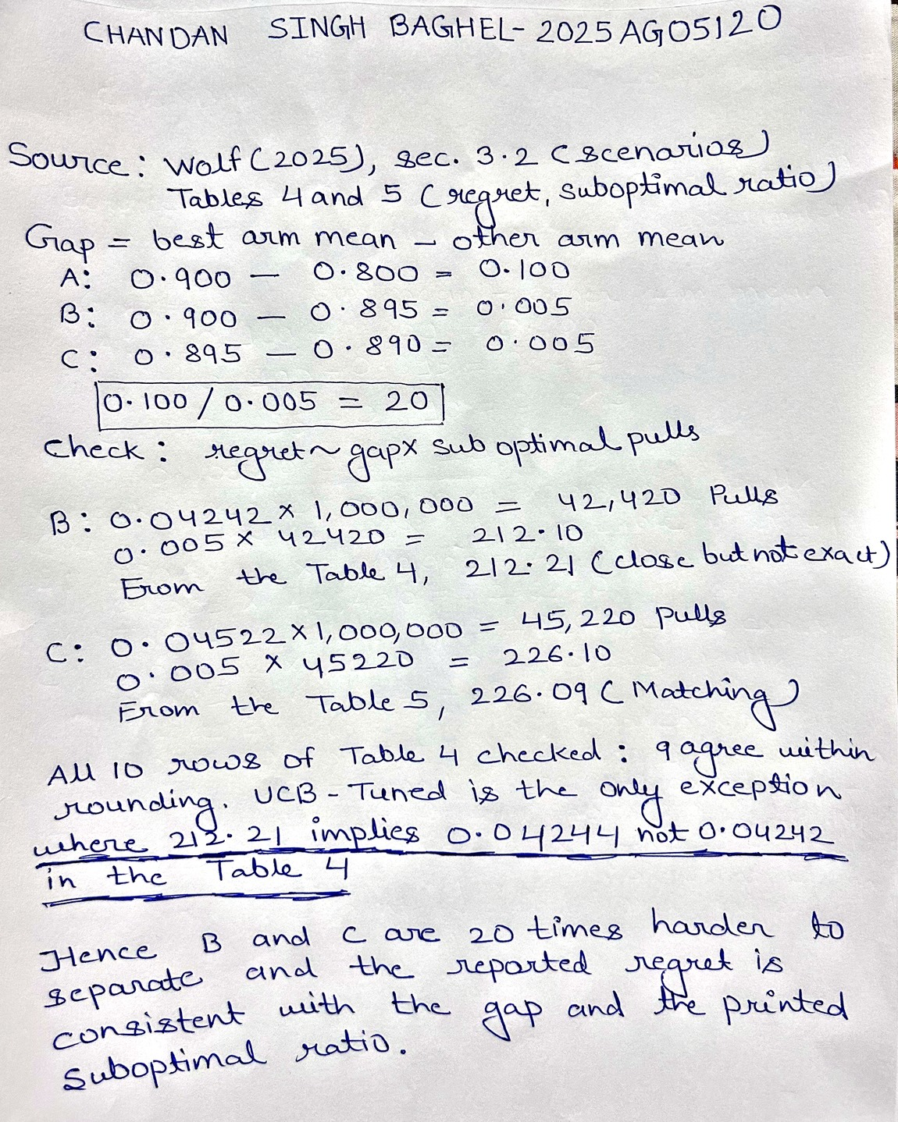
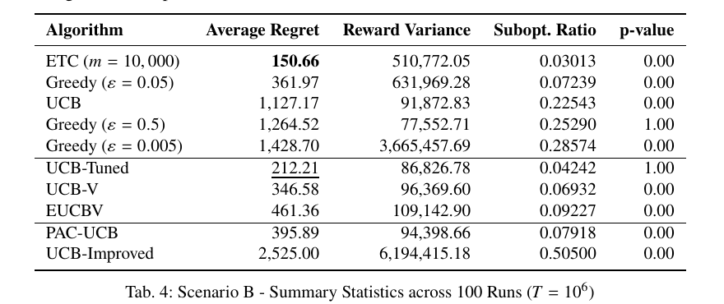
Chandan Singh Baghel — Working and Source
Problem difficulty from the reward gaps, and a consistency check on the paper's reported regret.
Paper source — Wolf (2025), Table 4, p.10
UCB-Tuned regret 212.21 — the value reconstructed on the right.
Group 8 | DRL Assignment Problem 1 | Variance-Aware Bandits | Sec. 1/5: Introduction | Slide 5 of 23
Contributor: Chandan Singh Baghel

Slide 6
Algorithms, Part I
Standard methods and non-variance-aware UCB extensions
Algorithm | Category | Core Idea | Config
ETC | Standard | Explore all arms uniformly for m rounds, then commit to the empirically best arm for the rest of the horizon. | m = 10… 10⁵
ε-Greedy | Standard | With probability ε, pick a random arm; otherwise pick the current best-known arm. | ε = 0.5… 0.005
UCB | Standard | Pick the arm with the highest upper confidence bound: Q̂(t) + √(2 log t / T(t)). | — none
PAC-UCB | Non-var.-aware | A UCB-V variant whose exploration term depends only on pull count — variance-independent confidence interval. | c=1, b=1, q=1.3, β=0.05
UCB-Improved | Non-var.-aware | Adaptive bounds with phased elimination; statistically unlikely arms are dropped each phase. | δ = 1
Config values per Table 1 of the paper. ETC and ε-Greedy are swept across several values to test under/over-exploration; algorithms with well-established defaults are evaluated as-is.
Group 8 | DRL Assignment Problem 1 | Variance-Aware Bandits | Sec. 2/5: Algorithms | Slide 6 of 23

Slide 7
Algorithms, Part II — Variance-Aware Methods
The paper's central algorithmic focus, with their confidence-bound formulas
UCB-V (Audibert, Munos & Szepesvári, 2009)
B(t) = Q̂ₐₖ(t) + √( 2·σ̂²ₐₖ(t)·ε / Tₐₖ(t) ) + c · 3bε / Tₐₖ(t) where ε = θ log(t)
Adds an empirical variance estimate σ̂² into the UCB bound; exploration term grows with log(t) if an arm is neglected. Config: θ=1, c=1, b=1.
UCB-Tuned (Auer et al., 2002)
EUCBV (Mukherjee et al., 2017)
Refines UCB's bound using an empirical variance term in place of the fixed constant. No formal regret bound is proven, but it consistently outperformed plain UCB in the original experiments. Config: none (no tunable parameters).
Combines the UCB-V variance-adaptive bound with an arm-elimination strategy. Parameters ρ and ψ control elimination aggressiveness. Config: ρ = 0.5 (ψ = n/K²).
For reference — plain UCB's bound (no variance term):
UCBₐₖ(t) = Q̂ₐₖ(t) + √( 2 log t / Tₐₖ(t) )
Variance-aware methods replace the fixed exploration term above with one scaled by each arm's own observed variance.
Source: Section 2.2–2.3 of the paper.
Group 8 | DRL Assignment Problem 1 | Variance-Aware Bandits | Sec. 2/5: Algorithms | Slide 7 of 23

Slide 8
Experimental Setup — Three Scenarios
Two-armed Bernoulli bandits across one large-gap and two micro-gap settings
Scenario | p₁, p₂ | Gap Δ | Reward Variance | Design intent
A — Baseline | 0.80, 0.90 | 0.10 | — (large, easy) | Clear-gap setting; baseline for exploitation efficiency.
B — Micro-Gap 1 | 0.895, 0.90 | 0.005 | ≈0.094 vs. 0.09 | Tiny mean gap near p=0.9; tests difficult arm discrimination.
C — Micro-Gap 2 | 0.89, 0.895 | 0.005 | ≈0.098 vs. 0.094 | Same tiny gap with shifted means and variances; not an independent variance intervention.
Every algorithm × every parameter setting × all 3 scenarios is run for T = 1,000,000 steps, repeated across 100 independent trials — producing both raw per-run data and averaged metrics.
Group 8 | DRL Assignment Problem 1 | Variance-Aware Bandits | Sec. 2/5: Algorithms | Slide 8 of 23

Slide 9
Methodology & Evaluation
How the comparison is kept fair, and how results are statistically validated
Design objective: all algorithms run under identical initialization, deterministic seeds, and normalized time progression, so observed differences reflect algorithmic principles — not implementation artifacts.
Fairness & reproducibility controls
Recorded metrics & statistical checks
Identical initialization — same arm-count / empirical-mean scheme for every algorithm.
Deterministic random seeds — every run is exactly reproducible.
Arm-order permutation — all orderings tested, removing tie-breaking bias.
Normalized time steps — UCB-Improved adapted to one pull per step, matching every other algorithm.
Open codebase (“Bandit Playground”) with structured CSV logs for independent replication.
Cumulative reward ΣXₖ and cumulative regret Rₜ = Σ(Q* − Qₐₖ), logged at logarithmically-spaced checkpoints up to T = 10⁶.
Suboptimal arm pulls and binary (0/1) reward outcome counts.
χ² test comparing each algorithm's observed reward variance at T = 10⁶ with the expected variance of the optimal arm — reported as a p-value.
Value-at-Risk, VaRα(Rₜ) at α ∈ {0.01, 0.05, 0.1} — summarizes upper regret quantiles and tail risk beyond the average.
Group 8 | DRL Assignment Problem 1 | Variance-Aware Bandits | Sec. 2/5: Algorithms | Slide 9 of 23

Slide 10
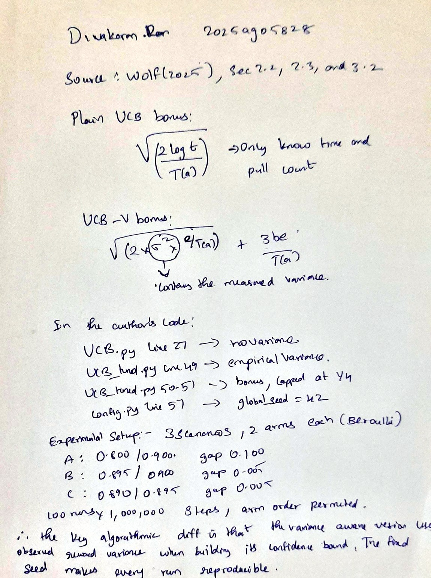
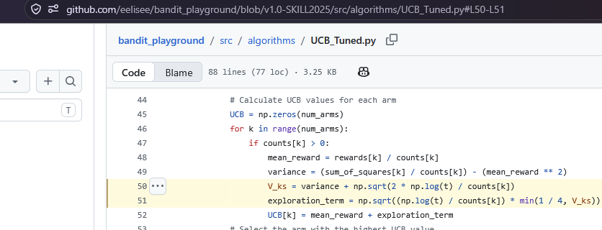
Divakaran Ramu — Working and Source
The one term that separates plain UCB from the variance-aware family, read from the author's own repository.
Code source — the author's repository, branch v1.0-SKILL2025
Same file, same repository: UCB.py line 27 has no variance term at all,
and config.py line 57 sets global_seed = 42, so every run reproduces exactly.
Group 8 | DRL Assignment Problem 1 | Variance-Aware Bandits | Sec. 2/5: Algorithms | Slide 10 of 23
Contributor: Divakaran Ramu

Slide 11
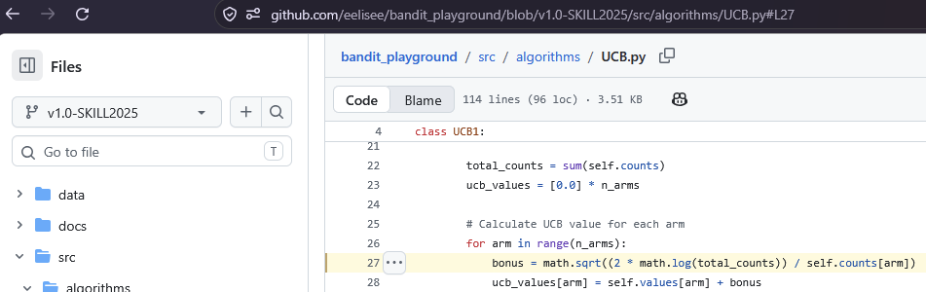
Divakaran Ramu — Source Code Trace (continued)
The contrast: plain UCB has no variance term anywhere, and the seed is fixed so every run reproduces.
Code source — the author's repository, branch v1.0-SKILL2025
UCB.py, line 27 — the exploration bonus uses only time and pull count
config.py, line 57 — the fixed seed behind every reported run
Group 8 | DRL Assignment Problem 1 | Variance-Aware Bandits | Sec. 2/5: Algorithms | Slide 11 of 23
Contributor: Divakaran Ramu

Slide 12
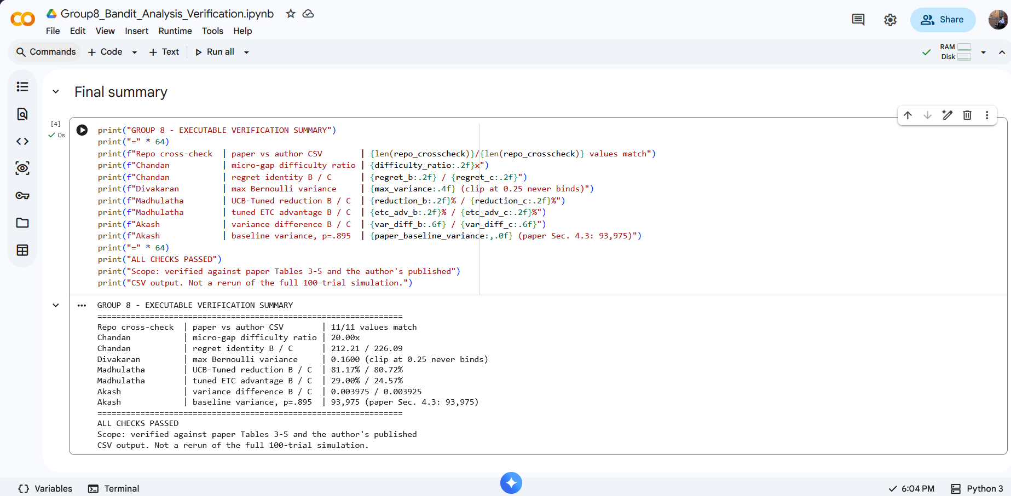
Executable Verification - Code and Actual Output
The script rechecks our arithmetic from paper Tables 3-5; it does not claim to rerun the full 100-run simulation.
Executed in Google Colab: Group8_Bandit_Analysis_Verification.ipynb, connected Python 3 runtime, the cell source, and the complete output including the 11/11 repository cross-check.
Notebook, view-only: https://colab.research.google.com/drive/12wYpQO9rKBayrKtyaUzfeYI8mZ7LpP2X?usp=sharing
Script, notebook and CSV output: github.com/CSB-sys/drl-group8-bandit-analysis
Group 8 | DRL Assignment Problem 1 | Variance-Aware Bandits | Sec. 3/5: Evidence | Slide 12 of 23
Contributor: Chandan Singh Baghel

Slide 13
Result Verification - Paper vs the Author's Published Data
How we obtained every number: each value printed in the paper was located in the author's own simulation output. 11 of 11 match.
Algorithm | Sc. | Paper | Author's CSV | File under data/ (final row, column 'Average Regret')
ETC (m=100) | A | 10.10 | 10.0950 | ETC/exploration_rounds_100/average_results_800_900.csv
UCB-Tuned | A | 30.67 | 30.6690 | UCB-Tuned/default/average_results_800_900.csv
EUCBV | A | 47.70 | 47.7270 | EUCBV/rho_0_5/average_results_800_900.csv
UCB | A | 238.17 | 238.1750 | UCB/default/average_results_800_900.csv
UCB-Improved | A | 32,500.11 | 32,500.1060 | UCB-Improved/delta_1/average_results_800_900.csv
ETC (m=10,000) | B | 150.66 | 150.6631 | ETC/exploration_rounds_10000/average_results_895_900.csv
UCB-Tuned | B | 212.21 | 212.2084 | UCB-Tuned/default/average_results_895_900.csv
UCB | B | 1,127.17 | 1,127.1738 | UCB/default/average_results_895_900.csv
ETC (m=10,000) | C | 170.53 | 170.5346 | ETC/exploration_rounds_10000/average_results_890_895.csv
UCB-Tuned | C | 226.09 | 226.0870 | UCB-Tuned/default/average_results_890_895.csv
UCB | C | 1,172.57 | 1,172.5742 | UCB/default/average_results_890_895.csv
11 of 11 values match. File names encode the arm probabilities: 800_900 = Scenario A, 895_900 = Scenario B, 890_895 = Scenario C.
Source: Wolf (2025), Tables 3-5 | author's data: github.com/eelisee/bandit_playground (v1.0-SKILL2025) | our check script: github.com/CSB-sys/drl-group8-bandit-analysis
Group 8 | DRL Assignment Problem 1 | Variance-Aware Bandits | Sec. 3/5: Evidence | Slide 13 of 23
Contributor: Kurella Madhulatha

Slide 14
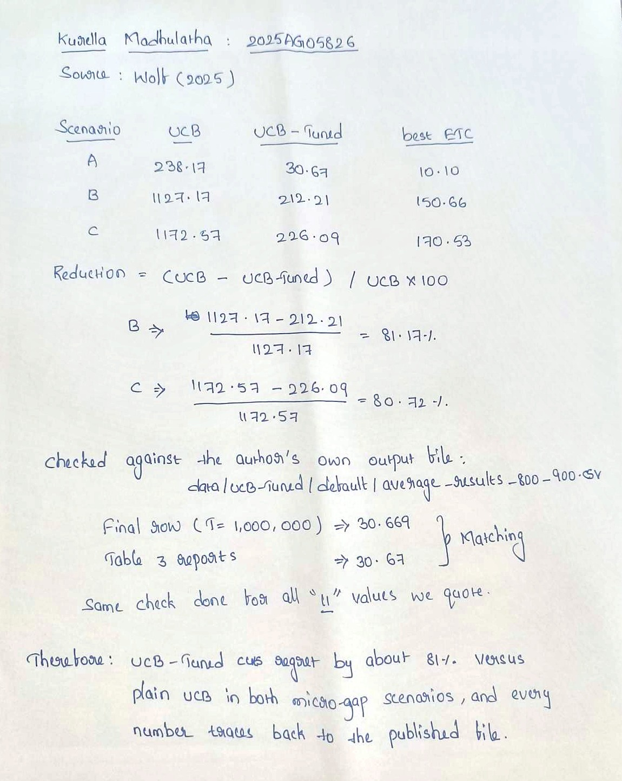
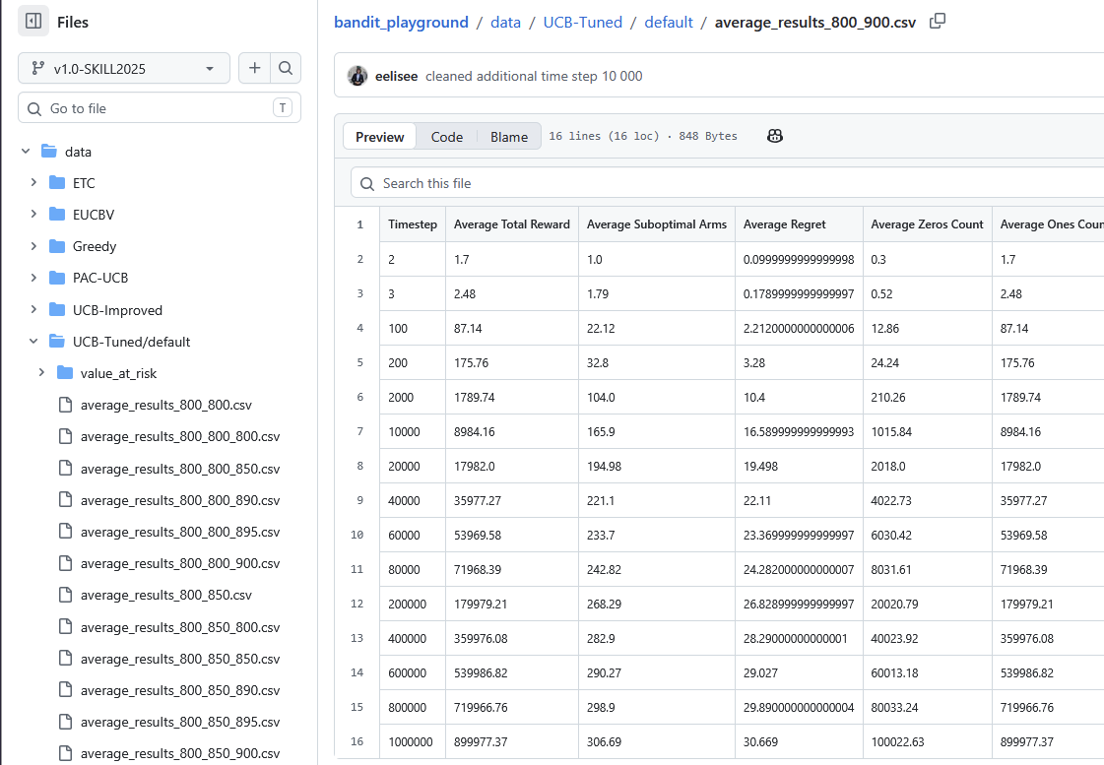
Kurella Madhulatha — Working and Source
Every regret value we quote, traced from the paper's table to the author's published simulation output.
Data source — the author's repository, branch v1.0-SKILL2025
Final row: Average Regret = 30.669 | Paper Table 3 reports 30.67
Group 8 | DRL Assignment Problem 1 | Variance-Aware Bandits | Sec. 4/5: Results | Slide 14 of 23
Contributor: Kurella Madhulatha

Slide 15
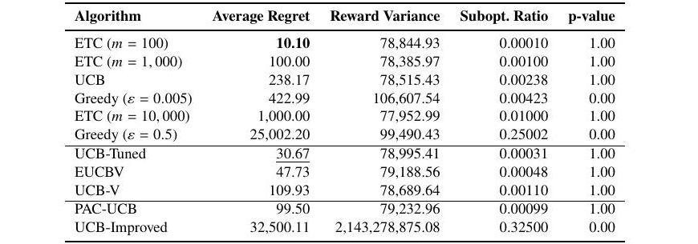
Results — Scenario A (Baseline)
Large reward gap: exploitation efficiency dominates
What happened
ETC (m=100) has the lowest regret (10.1, p=1.00), but relies on selecting an effective exploration length.
UCB-Tuned and EUCBV perform nearly as well (30.7 / 47.7); for both, the test does not detect a variance difference from the reference (p=1.00), and the reported configurations are not scenario-specific.
UCB-Improved performs worst — regret 32,500.11 and p=0.00; its observed reward variance differs significantly from the optimal-arm reference.
Source: Table 3, p.9 of the paper (11 reported configurations across 8 algorithm classes). Cross-checked against data/UCB-Tuned/default/average_results_800_900.csv (regret 30.6690).
Group 8 | DRL Assignment Problem 1 | Variance-Aware Bandits | Sec. 4/5: Results | Slide 15 of 23

Slide 16
Results — Scenario B (Low-Variance Micro-Gap)
Tiny reward gap (Δ=0.005), low variance
What happened
ETC (m=10,000) has the lowest regret (150.66), but its observed reward variance differs significantly from the optimal-arm reference (p=0.00), and the result relies on ideal calibration of m.
UCB-Tuned is the best untuned performer (regret 212.21); the test does not detect a variance difference from the reference (p=1.00).
Plain UCB underperforms badly (regret 1,127.17), consistent with difficulty separating the micro-gap arms without variance adaptation.
Excluded from chart for scale: Greedy(ε=0.005)=1,428.70 and UCB-Improved=2,525.00, both far worse.
Group 8 | DRL Assignment Problem 1 | Variance-Aware Bandits | Sec. 4/5: Results | Slide 16 of 23

Slide 17
Results — Scenario C (Micro-Gap 2)
Same tiny gap (Δ=0.005), with slightly shifted Bernoulli means and variances
What happened
ETC (m=10,000) again edges out everyone (170.53), but relies on knowing the ideal exploration length in advance. UCB-Tuned substantially beats plain UCB (226.09 vs. 1,172.57), the largest gap between these two methods in the paper. Because Bernoulli mean and variance change together, this result does not isolate variance as the cause. EUCBV reaches 476.31, while UCB-Improved again performs poorly at 2,450.00.
Group 8 | DRL Assignment Problem 1 | Variance-Aware Bandits | Sec. 4/5: Results | Slide 17 of 23

Slide 18
Cross-Scenario Trend & Key Takeaways
The gap between UCB and UCB-Tuned widens as the problem gets harder
Core insight
When the gap shrinks, both methods have higher regret than in Scenario A. The stronger comparison is within each micro-gap scenario: UCB-Tuned reduces regret versus plain UCB by 81.2% in B and 80.7% in C. Tuned ETC is lower still, but only with an exploration length selected for the environment.
Computed by Group 8 from Tables 4-5; both inputs cross-checked against the author's published CSV output (full verification table on slide 13).
Scenario | Best performer | Why it matters
A — Baseline (large gap) | ETC (m=100), then UCB-Tuned / EUCBV | Easy-to-tell-apart arms — simple exploitation wins.
B — Micro-Gap 1 | Heavily-tuned ETC, then UCB-Tuned | Well-tuned brute force can still win, but needs prior knowledge.
C — Micro-Gap 2 | ETC (m=10,000), then UCB-Tuned | UCB-Tuned is strong here, but variance is not independently controlled.
Group 8 | DRL Assignment Problem 1 | Variance-Aware Bandits | Sec. 4/5: Results | Slide 18 of 23

Slide 19
Limitations & Open Questions
As acknowledged by the authors (Section 5)
Two-armed focus — the framework supports up to three arms, but only two-armed settings were actually tested.
Stationary, binary rewards only — all experiments use i.i.d. Bernoulli rewards; no non-stationarity or richer reward types.
No delayed or contextual rewards — real-world settings often involve delayed feedback or context-dependent arms, both untested here.
Limited hyperparameter search — compute and data-volume constraints ruled out large-scale tuning sweeps.
Runtime / sample-complexity trade-offs unexamined — the paper does not analyze computational cost versus sample efficiency in depth.
No applied-domain validation — all results are on synthetic Bernoulli environments; no real-world deployment tested.
The authors frame these as threats to external generalizability rather than internal consistency of their findings.
Group 8 | DRL Assignment Problem 1 | Variance-Aware Bandits | Sec. 5/5: Analysis | Slide 19 of 23

Slide 20
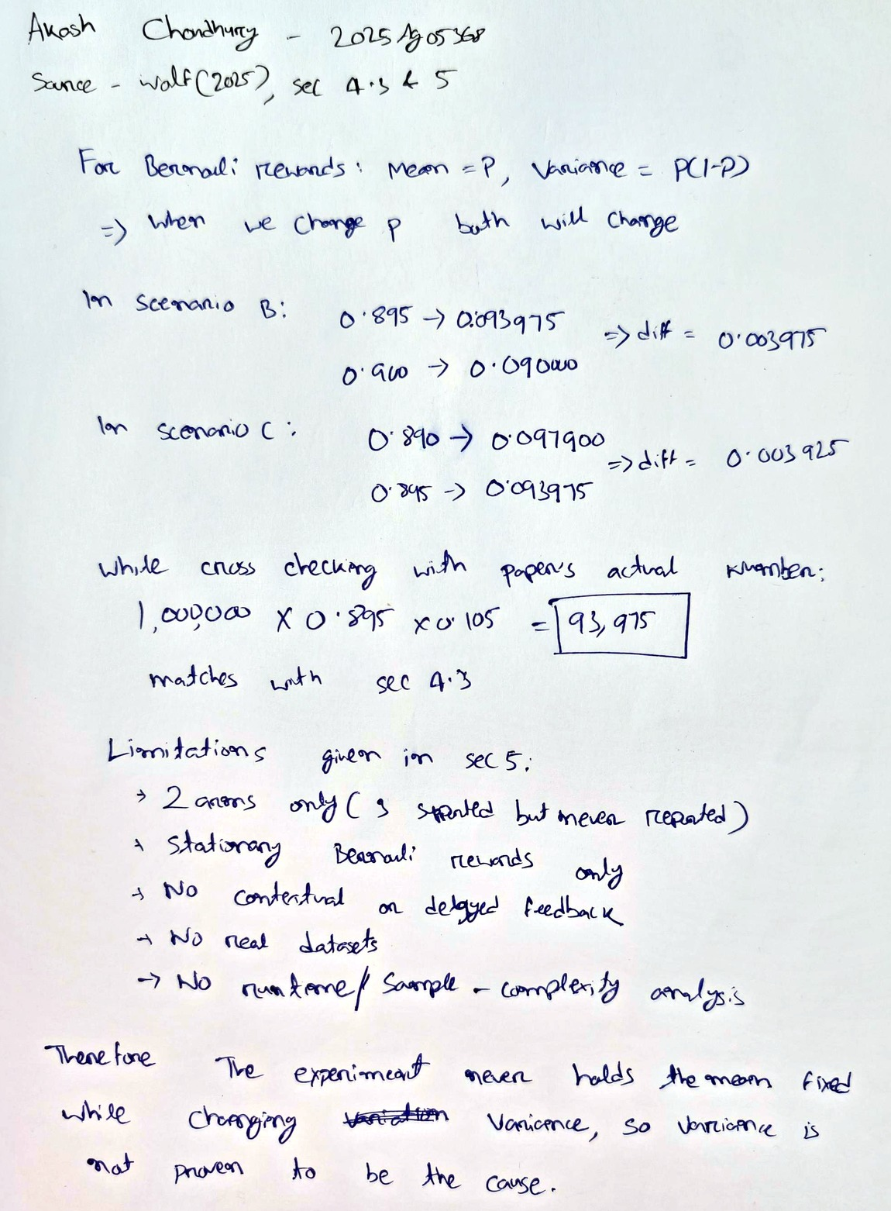
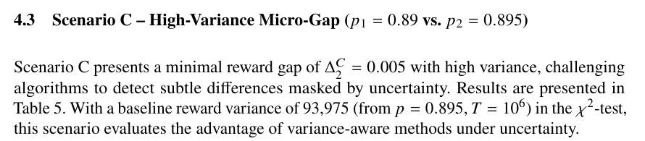
Akash Choudhury — Working and Source
Bernoulli mean and variance are coupled — and our hand calculation reproduces the paper's own printed figure.
Paper source — Wolf (2025), Section 4.3, p.10
Baseline reward variance 93,975 — reproduced by hand on the right.
Group 8 | DRL Assignment Problem 1 | Variance-Aware Bandits | Sec. 5/5: Analysis | Slide 20 of 23
Contributor: Akash Choudhury

Slide 21
Critical Reflection & Future Work
Our group's assessment of impact, and where this research could go next
Our Critique
Future Work
The paper's real contribution is methodological, not algorithmic — a fair-comparison protocol matters more for the field's credibility than one more bandit variant.
“Best-tuned ETC wins” is a fragile headline: it depends on knowing parameters unavailable in real deployments, so untuned methods like UCB-Tuned are arguably more meaningful winners.
The three-armed capability is built into the framework but never evaluated — a missed chance to demonstrate it scales beyond two arms.
The chi-square variance test is a nice rigor touch, but the paper doesn't report confidence intervals on regret itself.
Non-stationary & contextual bandits — real applications (recommenders, clinical trials) rarely have fixed, context-free reward distributions.
Runtime & sample-complexity analysis — practitioners need to weigh compute cost against regret reduction, not just final regret.
Applied-domain validation — testing on a real dataset would establish external validity beyond synthetic Bernoulli arms.
Full three-armed (or K-armed) evaluation — would demonstrate the framework's claimed scalability in practice.
Conclusion
The Bandit Playground shows that UCB-Tuned is a strong untuned choice in the tested low-gap Bernoulli settings, while correctly tuned ETC achieves the lowest regret. Because Bernoulli means and variances are coupled, the results do not establish variance as the causal driver. The paper's lasting contribution is a reproducible framework for making such comparisons fairly.
Group 8 | DRL Assignment Problem 1 | Variance-Aware Bandits | Sec. 5/5: Analysis | Slide 21 of 23
Contributor: Akash Choudhury

Slide 22
References
• Wolf, E. (2025). A Framework for Fair Evaluation of Variance-Aware Bandit Algorithms. arXiv:2510.27001.
• Auer, Cesa-Bianchi & Fischer (2002). Finite-time analysis of the multi-armed bandit problem.
• Audibert, Munos & Szepesvári (2009). Exploration–exploitation tradeoff using variance estimates.
• Mukherjee et al. (2017). Efficient-UCBV: An almost optimal algorithm using variance estimates.
• Lattimore & Szepesvári (2020). Bandit Algorithms. Cambridge University Press.
• Sutton & Barto (2018). Reinforcement Learning: An Introduction. MIT Press.
Group 8 | DRL Assignment Problem 1 | Variance-Aware Bandits | Sec. 5/5: Analysis | Slide 22 of 23

Slide 23
Proof of Work — Sources and Links
Everything behind this analysis, in one place, so any figure in this deck can be checked at source.
Research paper
Wolf, E. (2025). A Framework for Fair Evaluation of Variance-Aware Bandit Algorithms
arxiv.org/abs/2510.27001
Author's codebase
The Bandit Playground — algorithms, configuration and all simulation output
github.com/eelisee/bandit_playground (branch v1.0-SKILL2025)
Our verification repo
Our check script, notebook, generated output and handwritten working
github.com/CSB-sys/drl-group8-bandit-analysis
Executable verification
Group 8 notebook, run in Google Colab — all checks passed, 11/11 values matched
https://colab.research.google.com/drive/12wYpQO9rKBayrKtyaUzfeYI8mZ7LpP2X?usp=sharing
Handwritten working
One sheet per contributor, photographed — /handwritten in our repository
github.com/CSB-sys/drl-group8-bandit-analysis/tree/main/handwritten
Video recording
This presentation, recorded by all four contributors
https://drive.google.com/file/d/1SuPXFjT0oDmU_ZsAzD_fhdtOoxTqMz7e/view?usp=sharing
Group 8 | DRL Assignment Problem 1 | Variance-Aware Bandits | Proof of work index | Slide 23 of 23

